Slide 1
Nineveh University
College of Medicine
المؤتمر العلمي الطلابي السادس
بحوث طلبتنا ... تألق معرفي وابداع متميز

Slide 2
Knowledge & Attitude About Thalassemia Among undergraduate Students

Slide 3
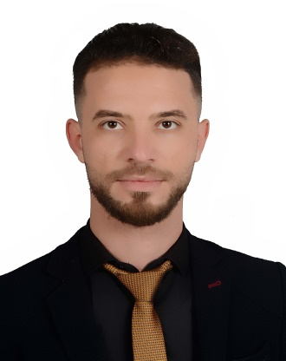
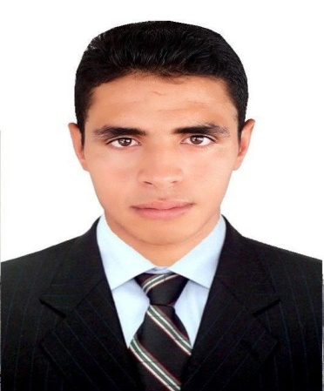
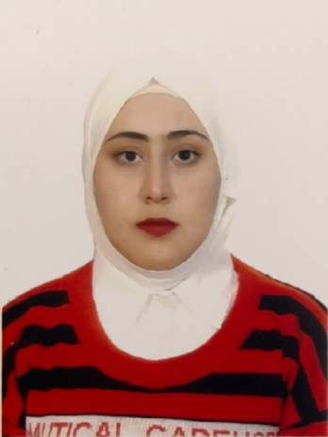
Presented by:
Ahmed Hameed Salman
Ahmed Ekab Ahmed
Essam Mudhaffer Ateyah
Falah Mohammed Nher
Suleiman Abdullah Khalaf
Zainab Haitham Khudair

Slide 4
Supervised by:
Dr. Amina Amer Alkhayat
Dr. Sura Obay Al-dewachi

Slide 5
Introduction
Thalassemia is the most prevalent congenital single-gene disorder globally, characterized by a deficiency of or decreased synthesis of either the alpha- or beta-globin chains in the hemoglobin protein of red blood cells and is passed down from parents to children.
B-thalassemia major is the most prevalent type in Iraq.
consanguineous marriage is one of the important influencing factors for thalassemia.

Slide 6
Aim of the study
To asses the knowledge and attitude of students from different Iraqi universities about Thalassemia.

Slide 7
Methodology
A cross sectional study conducted on (466) undergraduate students from Iraqi universities for the period between 14th of February and 6th of March 2023.
Data were collected using Google form platform via online questionnaire. The online questionnaire was distributed via groups on social media (WhatsApp, Facebook, Viber, and Telegram).

Slide 8
Results
Results were expressed in form of tables and figures of frequency and percentage.

Slide 10
Table 1. Participant knowledge regarding Thalassemia.
Correct knowledge | Number (%)
Disease transmission/infection-Hereditary. | 386(82.8%)
Consanguineous marriage increases the likelihood disease –True . | 399(85.6%)
which sexes are more likely to develop thalassemia-Both sexes. | 291(62.4%)
what are the most prevalent types of thalassemia in Iraq-Beta thalassemia | 134(28.8%)
How is thalassemia diagnosed- CBC ,Hemoglobin electrophoresis , Genetic test , Serum iron test. | 234(50.2%)
Thalassemia treatment major-regular blood transfusion. | 378(81.1%)
The final solution to thalassemia major-Stem cell transplant. | 280(60.1%)
Disease prevention-Premarital blood test , Blood tests during pregnancy before delivery. | 269(57.7%)
If the parents are carriers of thalassemia disease (not infected) , what is the probability that the children will be infected-25% | 111(23.8%)
If one of the parents is a carrier of thalassemia and the other is healthy , what is the probability of the children being affected-0% | 49(10.5%)
A person with thalassemia major is likely to survive-less than normal person. | 324(70.4%)
The probability of his survival A carrier of thalassemia has a chance of survival -There is no difference between him and normal person. | 201(43.1%)

Slide 11
2.Positive attitude toward thalassemia.
Correct knowledge | Number (%)
Have you done a blood test for yourself and made sure that you are safe from thalassemia. | 165(35.3%)
Have your family members been tested to ensure they are free from thalassemia. | 199(42.8)
Has any of your family members married a person who has thalassemia. | 50(10.8%)
Have you previously donated to thalassemia patients. | 58(12.5%)
Do you donate blood for thalassemia patients . | 355(76.1%)
Will you accept marriage with a person who is a carrier of thalassemia in the future. | 122(23%)
Do you accept marriage to someone from relatives . | 105(22.5%)
Will you take a thalassemia screening test before marriage . | 443(95.1%)
Do you recommend the need for pre- pregnancy tests . | 455(97.6%)
Do you recommend that people carrying the disease not marry each other . | 401(86.15)
In the event of the marriage of two carriers of the disease , do you recommend that they not have a child. | 336(72.2%)
In the event that a pregnant women is examined and it is proven that the child has thalassemia , do you recommend termination of pregnancy . | 185(39.6%)
Have you attended awareness seminars or lectures about thalassemia. | 83(17.8%)

Slide 12
Conclusion
This study concluded that the majority of students had satisfactory knowledge and positive attitude about the role of consanguinity and premarital screening for thalassemia.

Slide 13
Recommendations
Further studies are needed to asses knowledge , attitude and practice on a large scale population .

