Slide 1
المؤتمر الطلابي السادس لكلية الطب جامعة نينوى

Slide 2
Risk Factor of Polycystic Ovary Syndrom(PCOS) 2022/2023

Slide 3
Supervised By : Dr . Huda Abass Fadhel
Dr . Hiba Noori Saeed
Presented By :Rafal Waadallah Mousa
Sura Muthanna Ahmed
Zainab Osama Hamed
Aya Naktal Fadel
Sarah Ammar Hazem
Batoul Mohammed Ali

Slide 4
Introduction:
Polycystic ovary syndrome (PCOS) is a condition in which the ovaries produce an abnormal amount of androgens, male sex hormones that are usually present in women in small amounts . The name polycystic ovary syndrome describes the numerous small cysts (fluid-filled sacs) that form in the ovaries.
PCOS can occur at any age, from menarche onwards, most cases are diagnosed between the ages of 20 and 30 years old.

Slide 5
The etiology of PCOS is not completely understood and there is unknown cause .although a genetic component and diet/lifestyle factors, such as insulin resistance and obesity have been identified
The symptoms of PCOS may include:
Missed ,irregular or very light periods, Ovaries that are large or have many cysts ,Excess body hair (hirsutism) Weight gain ,Acne or oily skin ,Male-pattern baldness or thinning hair ,Infertility.

Slide 6
The risks for PCOS is :-
Obesity can increase Insulin levels build up in the body and may cause higher androgen levels.
PCOS may also run in families. It's common for sisters or a mother and daughter to have.
Aim of the study to estimate the association between pco and (family history ،obesity، irregular m.c).

Slide 7
Methodology
The study design that we adapted, is case-control & was done on female of Mosul city. Time period of the study was about two month.
The study was conducted among the females over a period of 6 days by using outpatient clinics and Google forms that were published and distributed using social media, was to collect a total of (90) samples

Slide 8
We depend on A special questionnaire (electronic) and The question items include:
clinical pictures and risk factor and ultrasonic findings and investigation of hormonal assays
we selected female with polycystic ovary syndrome was (30) case and normal female was (60) control.
We obtained ethical approval and permission from Nineveh Medical College and from all participants.

Slide 9
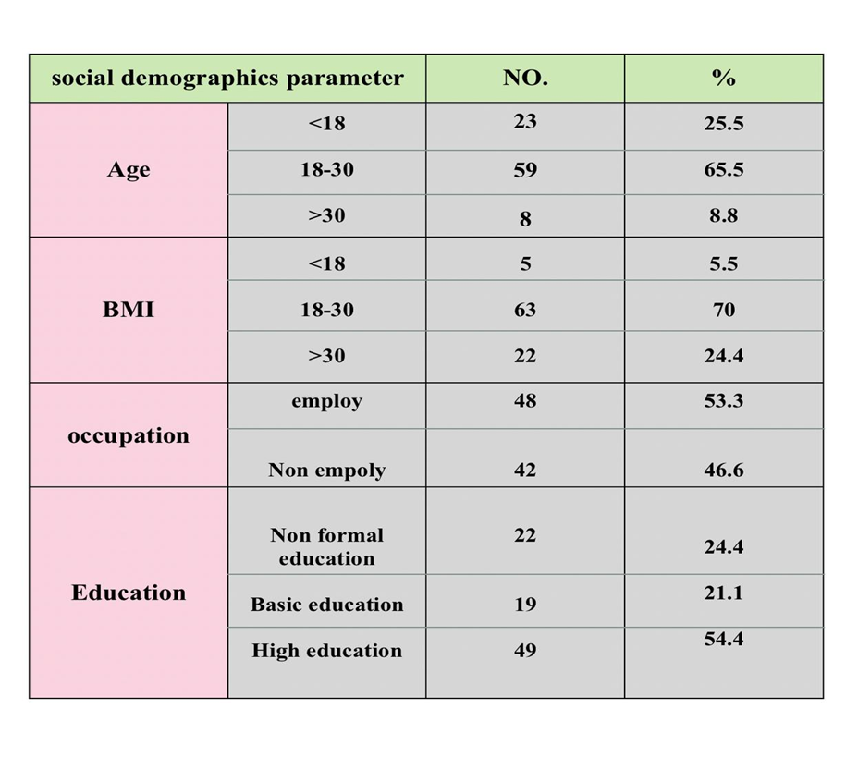
Results Table(1)Sociodemographic Parameter
This is retrospective
study made on
90 single female
patient.
These female
Subdivided into two
group case 33.3%
and control 66.6%

Slide 10
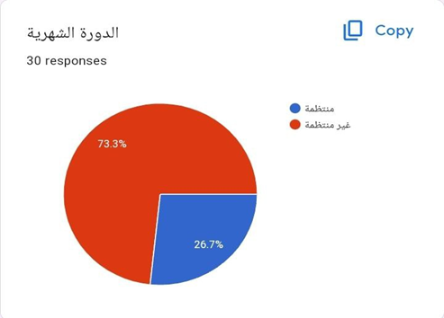
Table (2) Association between irregular menstrual
cycle and PCOs.
Pco.
Ttalo | Absense | Present
44 | 22 | 22 | Irregular
46 | 38 | 8 | regular
90 | 60 | 30 | Total
Menstrual cycle
Odd ration =4.75>1 so there is risk

Slide 11
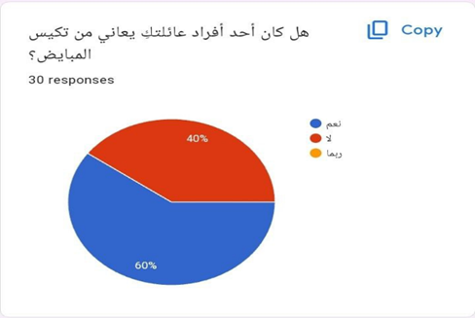
Table (3) Association between Family history of pcos and PCOs
Pco.
Family history of pco.
Odd ration = 1.6 so there is risk

Slide 12
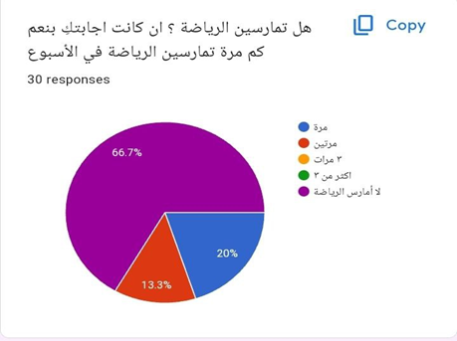
Table (4) Association between obesity and PCOs.
Pco.
BMI >30
obese
Odd ration = 14.3 >1 so there is risk

Slide 13
Discussion:
Based on the comparison between our study and the other studies ,the following results were obtained :
As we see in the table(2) the relation between pco and irregular menstrual cycle the OR= 4,75 we mentioned that is there is a risk association between pco & menstrual cycle irregularity .
Our research is applied with another research done by Isabel Cristina & others In brasil at 2014 in thire study they found there is an association between pco and irregular m.c the OR ratio was 1.93

Slide 14
In table (3) The relation between patients with PCOS &family history of pcos , our results reveal that is there
is a risk association between pco & family history of pco While other study presented by azziz & kashar in The University of Alabama at Birmingham at 2000 that there is a risk of family history appears to be the most informative risk factor for the development of PCOS.
In table (4) The relation between patients with PCOS & obesity (BMI), our results reveal that is there is a risk association between pco & obesity, While other study presented by Mohammed & other in Iran at 2022 they found that there is an association between pco &obesity .

Slide 15
Conclusion:
We found that pcos is more common in those with irregular menstrual cycle or positive family history or obesity than others.
Recommendation
Lifestyle changes, weight loss through a low calorie diet combined with moderate exercise activities. Even a modest reduction in weight. for example, losing 5% of body weight.

Slide 16
Thank you

