Slide 1
Nineveh university college of medicine
بحوث طلبتنا ...... تألق معرفي وإبداع متميز
المؤتمر الطلابي السادس
بحوث طلبتنا….. تألق معرفي وإبداع متميز

Slide 2
PREVALNCE OF PREMENSTRUAL SYNDROME AMONG MEDICAL STUDENTS IN MOSUL UNIVERSITIES
بحوث طلبتنا ...... تألق معرفي وإبداع متميز

Slide 3
بحوث طلبتنا ...... تألق معرفي وإبداع متميز
Supervised By :
Asst.prof. Dhukaa AL Jawadi
Dep. of OBGYN
Dr. Amina A. Al-khayat
Dep. of family & community medicine

Slide 4
بحوث طلبتنا ...... تألق معرفي وإبداع متميز
Aya A. Fakhri

Slide 5
introduction :
بحوث طلبتنا ...... تألق معرفي وإبداع متميز
Menstruation or period is the monthly bleeding of a woman. This period extended between the first day of a bleeding and the first day of the next period. During this time, the woman experiences changes in her body, especially in the uterus and ovaries of her reproductive system, due to the action of the female sex hormones (FSH, LH, estradiol and progesterone) that are preparing the body for a possible pregnancy.

Slide 6
بحوث طلبتنا ...... تألق معرفي وإبداع متميز
introduction :
Premenstrual syndrome (PMS) encompasses clinically significant somatic and psychological manifestations during the luteal phase of the menstrual cycle, leading to substantial distress and impairment in functional capacity.
These symptoms disappear within a few days of the onset of menstruation. The pooled prevalence of reproductive age women affected with PMS worldwide amounts to 47.8%.
Among these, about 20% of women experience symptomssevere enough to disrupt their daily activities

Slide 7
بحوث طلبتنا ...... تألق معرفي وإبداع متميز
Objectives :
Aim & specific objects of this study:
Is to study the premenstrual cycle among the students of different medical colleges from 5th December 2022 till 19th February 2023
Find out the prevalence of premenstrual syndrome among medical university students.in different colleges and fields in Nineveh governorate.
Compare the prevalence of PMS among different college samples.
Signify the relationship between the regularity of the menstrual cycle among study participants who have the symptoms and who don’t, also to examine if there is a significant relationship between the marital state &PMS.

Slide 8
بحوث طلبتنا ...... تألق معرفي وإبداع متميز
Objectives :
Aim & specific objects of this study:
4. To detect the statical significance of BMI of the study participants
with premenstrual syndrome.
5. Classify the distribution of the symptoms among the study participants.
6. Schedule the attitude of the symptomatic subjects toward symptoms.

Slide 9
بحوث طلبتنا ......انطلاقة نحو نهضة علمية
Methodology:
Random sample of 600 student participated from different medical universities in Nineveh governorate.
female university students filled two self-administered structured questionnaire that included personal information and the validated Arabic Premenstrual Syndrome Scale
Cross section study has been adopted , from 5th December 2022 till 19th February 2023 And was performed among students in Nineveh universities, included medical colleges only
All data management and analysis was done by using Excel 2016 and chi-square Test for statistical computing.

Slide 10
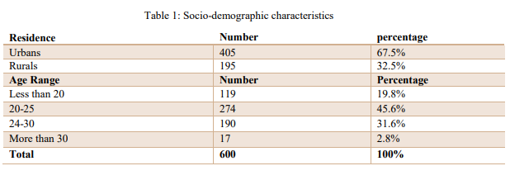
بحوث طلبتنا ...... تألق معرفي وإبداع متميز
Results :
1- General demographic characteristics:
Prevalence of PMS among the study subjects
In this study ,450 (75%) of the study subjects suffered from symptoms of PMS .
2- Socio-demographic characteristics:

Slide 11
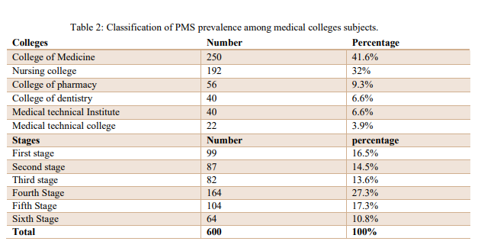
بحوث طلبتنا ...... تألق معرفي وإبداع متميز
Results :
3-Classification of PMS prevalence among medical colleges subjects:

Slide 12
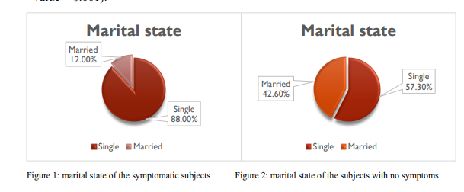
بحوث طلبتنا ...... تألق معرفي وإبداع متميز
There was Significant association between marital state and PMS
( p - value = 0.001)

Slide 13
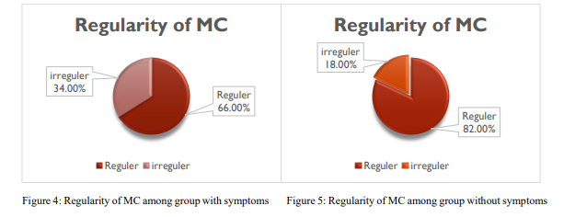
بحوث طلبتنا ...... تألق معرفي وإبداع متميز
There was Significant association between cycle reguilarity and PMS
( p - value = 0.001)

Slide 14
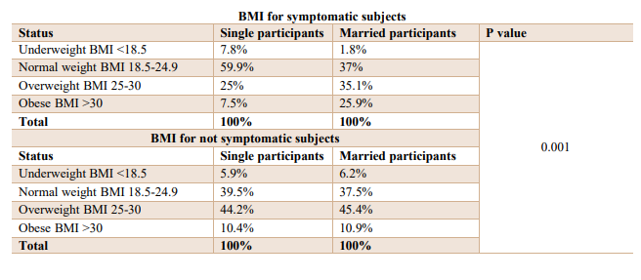
بحوث طلبتنا ...... تألق معرفي وإبداع متميز
There was a significant relationship between normal BMI & abnormal BMI to PMS, (underweight, overweight& obesity were considered to be abnormal BMI), (p - value = 0.001), also there was a significant relationship between normal BMI& abnormal BMI to the marital state of symptomatic participants. (p - value = 0.002) .

Slide 15
بحوث طلبتنا ...... تألق معرفي وإبداع متميز
Result :
Breast tenderness
Anxiety& loss of concentration
Increase in Appetite
Decrease in Appetite
Tiredness & fatigue
Breast Tenderness
Abdominal bloating
Constipation
Diarrhea
Lower Back pain
Abdominal Cramps
The symptomatic subjects were asked about the exact symptoms they suffered from, 450 (100%) suffered from some type of PMS symptoms, the most frequent PMS symptoms were abdominal cramps 428(95.1%), lower backache 312(69.3%)& tiredness & fatigue 305(67.8%), breast tenderness 189 (42%). Most frequent psychological symptoms were anxiety & loss of concentration 352(78.2%).

Slide 16
بحوث طلبتنا ...... تألق معرفي وإبداع متميز
IV Fluids
Hot Drinks
Feet Warmth
Medical herbs “chamomile,cinnamon”
Hot pads
Analgesics use
Do Nothing
Laying down & sleep
In consideration of the attitude of the study subjects ,high percentage of the Study subjects chooses laying down & sleep as their favorite way to deal with the symptoms 211(46.9%), 104(23.3%) uses analgesics, minority of the study subjects (0.4%) use IV fluid which reflect the severity of the symptoms.

Slide 17
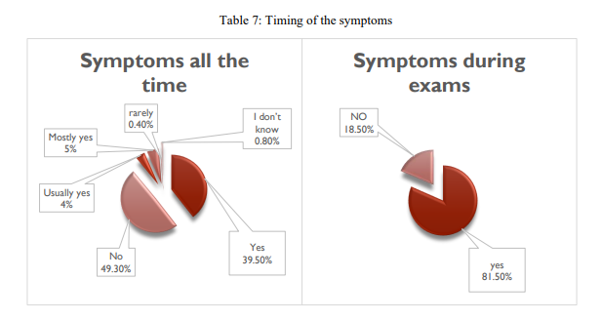
بحوث طلبتنا ...... تألق معرفي وإبداع متميز
Most of symptomatic study subjects said that the symptoms don’t appear all the time 222(49.3%) and 178 (39.5%) say that the symptoms were present all the time, on the other side, most of participants 376(81.5%) think that symptoms appear during exams . which reflect a strong relationship between exams & PMS symptoms.

Slide 18
Conclusion
بحوث طلبتنا ...... تألق معرفي وإبداع متميز
1- PMS is very serious issue among female students with high prevalence (75%).
2- symptoms reported by all symptomatic study subjects. The most frequent PMS Physical
symptoms were: abdominal cramps, which was more than 95% of the participants suffer
from and back pain, while the most frequent psychological symptoms included loss of
concentration & anxiety.
3- Majority of the participants chooses laying down & sleep as their favorite way to deal
with the symptoms 211(46.9%), 104(23.3%) uses analgesics, (0.4%) of the participants use
IV fluid which reflect the severity of the symptoms

Slide 19
Recommendation
بحوث طلبتنا ...... تألق معرفي وإبداع متميز
1- Changing lifestyle ,which including reducing stress as much as possible by creating a soothing environment, getting enough sleep, emotional support, practice deep breathing or meditation, and connect with others, as the high prevalence of PMS among university students & a significant relationship was found among the symptomatic females with timing of exams and cycle regularity, requires an action to help and support those who suffer a lot.
2- Raising awareness toward this syndrome is a necessary. Education programs can be adopted by various ways including traditional educational module or using innovative
technological methods

Slide 20
بحوث طلبتنا ...... تألق معرفي وإبداع متميز
Thank you
for your attention

