Slide 1
Ninevah University
College of Medicine
المؤتمر الطلابي السادس
بحوث طلبتنا ... تألق معرفي وإبداع متميز
2022-2023

Slide 2
Characteristics Affecting the Choice
of Family Planning Method among
the Women in Mosul

Slide 3
Supervised by
ASST.Prof.Dr. Dhukaa’ Abbas
AL-Jawadi
Dr. Delal Ahmad Al-Aljumaily
Department of family and community medicine
Department of obstetrics and gynecology

Slide 4
Presented by
Hero Deldar Abdullah
Zeena Hisham Ramzi
Asmaa Ahmed Owaid
Abdullah Ahmed Khalaf
Shurooq Najeeb jader
Lubna Emad Hameed
Mohammed Hussein Hassan

Slide 5
INTRODUCTION
Context : Family planning is defined as those practices that help the couples to avoid unwanted pregnancy.
The main aim of having contraceptive method is to increase the birth interval for at least 2years or more in order to promote the health of the mother & her infants, protecting her against high risk pregnancy & plan for having children at a time that the family condition in relation to the socio-economic &health status permits.
Also to avoid the risk of having unwanted pregnancy which makes the pregnant woman intending for illegal abortion & consequently her health will deteriorate both medically &psychologically.

Slide 6
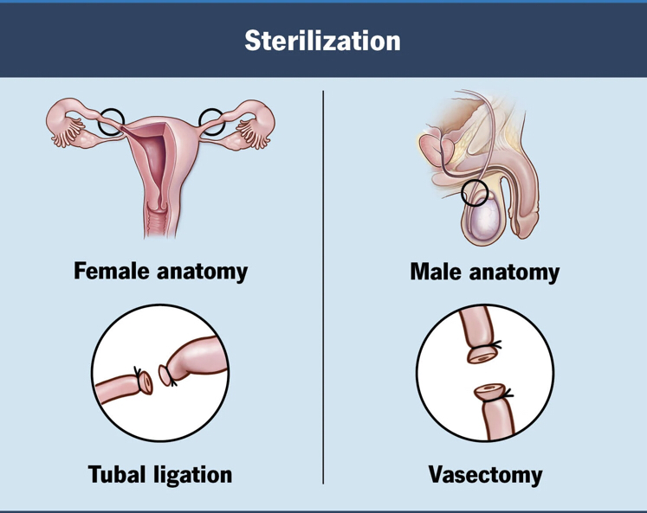
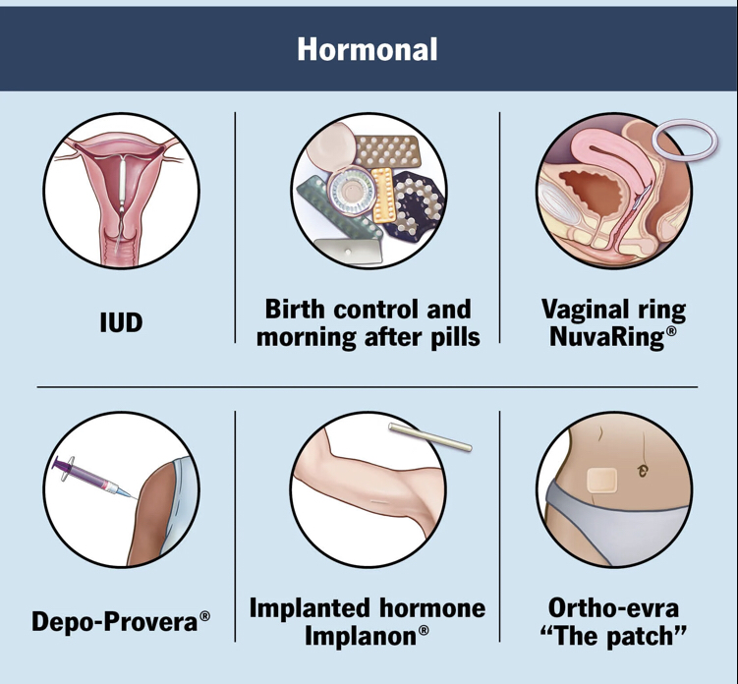
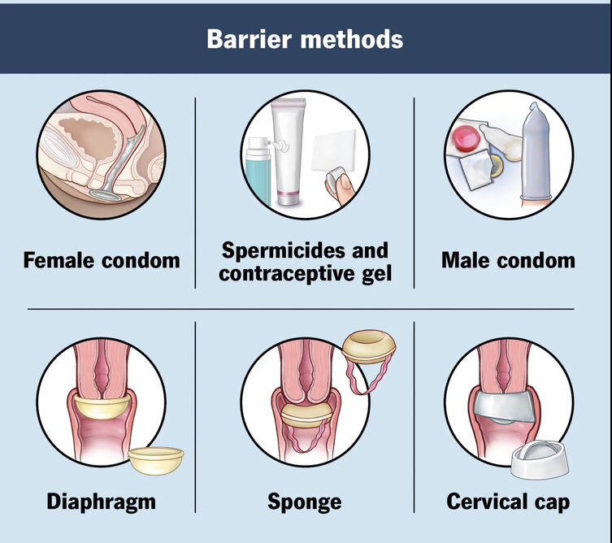
Types of contraceptive methods

Slide 7
Objectives:
The present study aimed to clarify the socio-demographic, economic, medical & obstetric characteristics which affect the choice of family planning method in postnatal women attending family planning units.

Slide 8
Study design
cross sectional study
Sampling
Random sample of 304 women
Study setting
Interview questionnaire
Al-Batool teaching maternity hospital, Al-quds and Al-wahda PHCC
Methodology
family planning record made by Iraqi ministry of health
Screening period
Statistical analysis
was done by using Microsoft Excel 2013
2nd-21st of February
2023

Slide 9
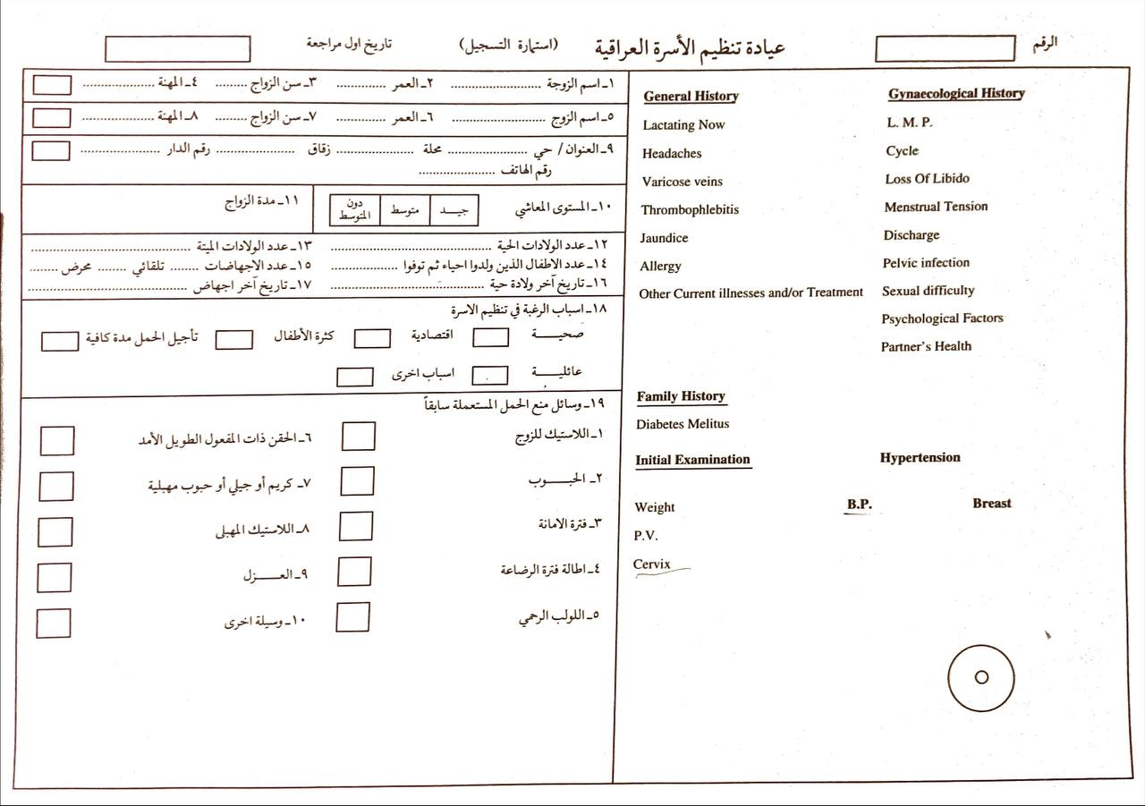
Family planning record conducted by Iraqi ministry of health

Slide 10
Table (1)
Table(1) Socio-demographic characteristics of the study sample :
Percentage | Variable
 | 1-Age (mean ± SD= 25 ± 6.7)
11.6% | 15-24
%47.4 | 25-34
%28.1 | 35-44
%12.9 | ≥45
 | 2-Duration of marriage (mean ± SD= 33.2 ± 9.2)
%13.6 | <5 years
%36.5 | 6-10
%49.6 | 11<
 | 3-Occupation
%83.4 | Housewives
%16.6 | Occupied
 | 4-Residence
%93.5 | Urban
%6.5 | Rural
 | 5-Level of education
%11.9 | a-No formal education
%57.5 | b- 6-12 years
%30.6 | c- >12 years
Table (2)
Table (3)
RESULTS
Table (4)
Table (5)
Table (6)

Slide 11
Table (1)
Table(2) Medical variables distribution among the sample :
Table (2)
Variables | Percentage
Headache | 35.1%
Psychological factors | 27.9%
Hypertension | 26.0%
Lactating now | 17.2%
Allergy | 17.2%
Varicose vein | 15.9%
Diabetes mellitus | 14.6%
Jaundice | 9.4%
Thrombophlebitis | 8.8%
Table (3)
RESULTS
Table (4)
Table (5)
Table (6)

Slide 12
Table (1)
Table(3) Distribution of the obstetric variable among the study subjects :
Table (2)
Percentage | Variables
 | Parity
0.0% | 0
66.1% | 1-4
33.9% | ≥5
18.1% | Abortion
17.0% | 0
76.6% | 1-2
6.4% | ≥3
69.2% | Spontaneous Abortion
30.8% | Accidental Abortion
11.8% | Still birth
Table (3)
RESULTS
Table (4)
Table (5)
Table (6)

Slide 13
Table (1)
Table(4) Classification of the gynecological parameters among the study sample :
Table (2)
Parameters | Percentage
Pelvic inflammation | 30.9%
dysmenorrhea | 25.7%
Loss of libido | 23.3%
Sexual difficulty | 20.1%
Vaginal discharge: a-No discharge b-Abnormal discharge | 70.4% 29.6%
Menstrual cycle: a- Regular b- Irregular | 69.8% 30.2%
Table (3)
RESULTS
Table (4)
Table (5)
Table (6)

Slide 14
Table (1)
Table(5) Causes of using family planning methods among the study
women :
Table (2)
Percentage | Reasons
%31.9 | High parity
%21.5 | Family causes
%19.7 | Socioeconomic
%14.3 | Child spacing for>2years
%12.6 | Medical
0.0% | Others
Table (3)
RESULTS
Table (4)
Table (5)
Table (6)

Slide 15
Table (1)
Table(6) Contraceptive methods used among the study sample:
Table (2)
P value | Percentage | Methods
0.02 | 40.6% | Oral contraceptive pills
 | 27.4% | Depo Provera injection
 | 11.3% | IUCD
 | 11.0% | Vaginal pills
 | 8.4% | Male condom
 | 3.2% | Isolation
 | 1.3% | Safety period
 | 0.3% | Female condom
 | 0.3% | Lactation
 | 2.6% | Other methods
Table (3)
RESULTS
Table (4)
Table (5)
Table (6)

Slide 16
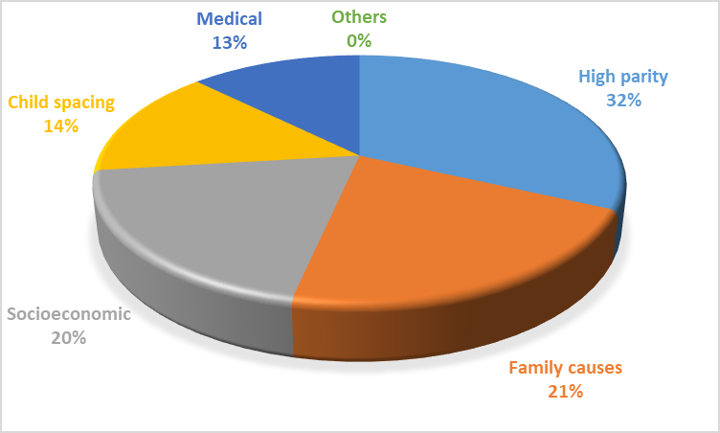
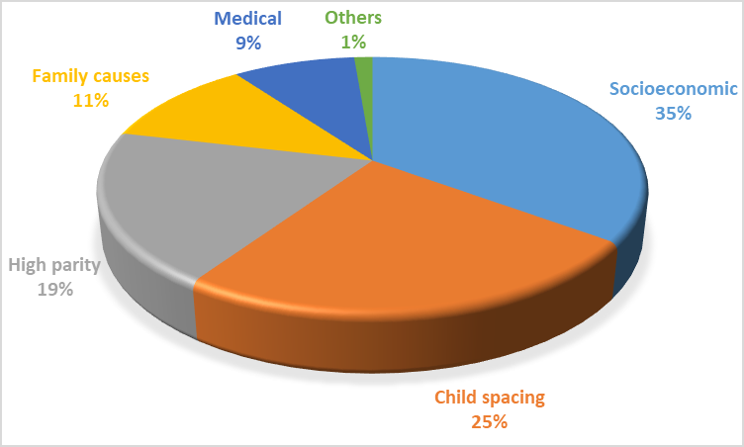
Discussion
Mosul , Iraq 2023
Dakahlia , Egypt 2020

Slide 17
Conclusion
It was concluded that, family planning is very important for ensuring the health of the mother & her infants. Different methods of family planning were available & accessable for the postnatal women attending family planning unit. Many significant variables can affect the choice of family planning methods especially high parity, lengthening the child spacing & urban residence. The reason of deteriorating socio- economic status during the meantime have an important role in increasing number of women asking for contraceptive methods rather than other causes (medical, high parity or increasing birth interval).

Slide 18
Recommendation
1- Encouraging the women to get access to the family planning unit & making the contraceptive methods more available & accessable especially for rural areas because far areas & cost of transport can impede the reach of these methods to the rural women.
2- Emphasize the role of the health education through the mass media about the use of family planning methods in order to promote the health of the mother & her infant .
3- The use of male condom should be encouraged as an effective contraceptive method with explaining its additive role in decreasing the spread of sexually transmitted diseases .

