Slide 1
Ninevah university College of medicine
المؤتمر الطلابي السادس بحوث طلبتنا .. تألق معرفي وإبداع متميز
Patients’ Perceptions Towards the Participation of Medical Students in Their Care

Slide 2
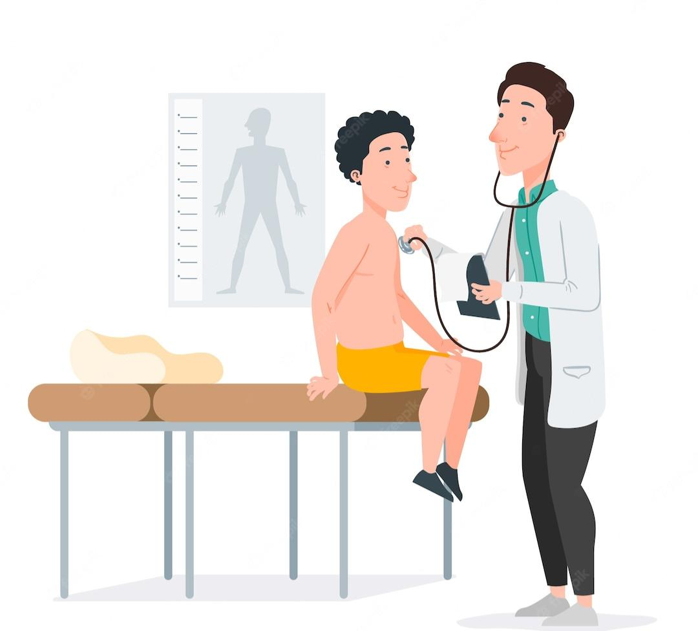
Patients’ Perceptions Towards the Participation of Medical Students in Their Care

Slide 3
Presented by
Nu’as W. Ahmed
Ismael M. Abd-Alkareem
Harith A. Khalaf
Kawther A. Ismael
Yasmeen N. Abdullah
Noor A. Mahmood

Slide 4
Supervised by
Dr. Dhelal Ahmed Aljumaily
Department of Family and Community medicine
Dr. Rasha Nadeem Ahmed
Department of Surgery

Slide 5
Introduction
Patients Examination is an essential part of medical education, through interaction with real patients, medical students learn the most important skills like critical thinking, diagnosis, and management of many diseases, in addition to leadership, empathy, communication, and professionalism. These skills are needed for the medical student to become an efficient physician.

Slide 6
Introduction
Such a good relationship is needed to be built between the student and patient as well, to get the maximum benefit from clinical training.
Focusing on patient’s rights increasingly causes difficulty in clinical teaching, a conflict can rise between patients’ needs and the requirements of medical education.

Slide 7
Aim of study
to explore patients’ opinions, how they feel, and the degree of their comfort upon examination done by students.

Slide 8
Patients and methods
Study design and setting
An observational descriptive and analytic cross-sectional multicentric study, held in Mosul city between February 2023 and April 2023, in the Five major teaching hospitals in the city,
Sample size calculation
the sample size was calculated to be 161 patients, the total number is adjusted to 206.
Statistical analysis
Data were saved by using Microsoft Excel 2020 and the statistical analysis was conducted using SPSS (Version 17).

Slide 9
Patients and methods
Data collection
a written questionnaire was used to collect information, direct face-to-face interviews were conducted, and Participants from different departments were included (Internal Medicine, Surgery, Obstetrics and Gynecology, and Pediatrics).
Ethical consideration
Ethical approval was obtained from the ethical committee of the College of Medicine, Ninevah University, and informed consent was obtained from all the participants.

Slide 10
Results
A total of 219 patients were approached (response rate of 94%).
The median age was 27 years and the range is (4 days– 87 years old), (62.1%) of them were females with (37.9%) males.

Slide 11
Patients' Perceptions Towards The Participation Of Medical Students In Their Care
Questions | Answers N(%)
 | Males only | Females only | Both | Neither
Would you permit medical students to read your medical file? | 0 (0) | 3 (1.5) | 197 (95.6) | 6 (2.9)
Would you permit medical students to be present in the outpatient clinic if you were having a consultation with your doctor? | 0 (0) | 30 (14.6) | 156 (75.7) | 20 (9.7)
Would you permit medical students to be present in the operation room if you were having a surgery? | 0 (0) | 35 (17) | 152 (73.8) | 19 (9.2)
Would you permit medical students to take your medical history and personal details from you with the presence of a doctor? | 0 (0) | 7 (3.4) | 195 (94.7) | 4 (1.9)
Would you permit medical students to take your medical history and personal details from you without the presence of a doctor? | 0 (0) | 7 (3.4) | 182 (88.3) | 17 (8.3)
Would you permit medical students to be present while your doctor examining you? | 0 (0) | 49 (23.8) | 141 (68.4) | 16 (7.8)
Would you permit medical students to examine you with the presence of a doctor? | 0 (0) | 52 (25.2) | 130 (63.1) | 24 (11.7)
Would you permit medical students to examine you without the presence of a doctor? | 0 (0) | 42 (20.4) | 94 (45.6) | 70 (34)
Would you permit medical students to be present while you're having diagnostic/other procedures (e.g. drawing blood, inserting catheter, etc.) | 0 (0) | 9 (4.4) | 193 (93.7) | 4 (1.9)
Would you permit medical students to perform diagnostic/other procedures on you (e.g. drawing blood, inserting catheter... etc.) | 0 (0) | 8 (3.9) | 113 (54.9) | 85 (41.3)

Slide 12
 | Would you permit medical students to be present in the operation room if you were having a surgery?
 | N ( % )
 | Male Students | Female Students | Both | Neither | P
Age
≤ 15 years | 0 (0) | 0 (0) | 52 (94.5) | 3 (5.5) | < 0.001
16-25 years | 0 (0) | 12 (30) | 23 (57.5) | 5 (12.5)
26-45 years | 0 (0) | 21 (31.3) | 42 (62.7) | 4 (6)
≥ 46 years | 0 (0) | 2 (4.5) | 35 (79.5) | 7 (15.9)
Gender
male | 0 (0) | 0 (0) | 69 (88.5) | 9 (11.5) | < 0.001
Female | 0 (0) | 35 (27.3) | 83 (64.8) | 10 (7.8)
Marital Status
Married | 0 (0) | 31 (24.8) | 81 (64.8) | 13 (10.4) | < 0.001
Unmarried | 0 (0) | 4 (4.9) | 71 (87.7) | 6 (7.4)
Educational Level
Non Formal Education | 0 (0) | 23 (14.5) | 121 (76.1) | 15 (9.4) | 0.304
Basic Education | 0 (0) | 6 (20.7) | 21 (72.4) | 2 (6.9)
High Education | 0 (0) | 6 (33.3) | 10 (55.6) | 2 (11.1)
How many times did the patient visit the hospital for the same illness
0-3 times | 0 (0) | 29 (16.4) | 130 (73.4) | 18 (10.2) | 0.756
≥ 4 times | 0 (0) | 6 (20.7) | 22 (75.9) | 1 (3.4)
how long did the patient stay in the hospital
0-5 days | 0 (0) | 34 (18.6) | 134 (73.2) | 15 (8.2) | 0.078
≥ 6 days | 0 (0) | 1 (4.3) | 18 (78.3) | 4 (17.4)
Department
Internal medicine | 0 (0) | 6 (10.9) | 43 (78.2) | 6 (10.9) | < 0.001
Surgery | 0 (0) | 5 (9.8) | 39 (76.5) | 7 (13.7)
Obstetric | 0 (0) | 24 (41.4) | 29 (50) | 5 (8.6)
Pediatric | 0 (0) | 0 (0) | 41 (97.6) | 1 (2.4)

Slide 13
 | Would you permit medical students to examine you with the presence of a doctor?
 | N ( % )
 | Male Students | Female Students | Both | Neither | P
Age
≤ 15 years | 0 (0) | 1 (1.8) | 50 (90.9) | 4 (7.3) | < 0.001
16-25 years | 0 (0) | 22 (55) | 11 (27.5) | 7 (17.5)
26-45 years | 0 (0) | 26 (38.8) | 31 (46.3) | 10 (14.9)
≥ 46 years | 0 (0) | 3 (6.8) | 38 (86.4) | 3 (6.8)
Gender
male | 0 (0) | 0 (0) | 70 (89.7) | 8 (10.3) | < 0.001
Female | 0 (0) | 52 (40.6) | 60 (46.9) | 16 (12.5)
Marital Status
Married | 0 (0) | 42 (33.6) | 64 (51.2) | 19 (15.2) | < 0.001
Unmarried | 0 (0) | 10 (12.3) | 66 (81.5) | 5 (6.2)
Educational Level
Non Formal Education | 0 (0) | 38 (23.9) | 106 (66.7) | 15 (9.4) | 0.118
Basic Education | 0 (0) | 10 (34.5) | 15 (51.7) | 4 (13.8)
High Education | 0 (0) | 4 (22.2) | 9 (50) | 5 (27.8)
How many times did the patient visit the hospital for the same illness
0-3 times | 0 (0) | 37 (20.9) | 117 (66.1) | 23 (13) | 0.006
≥ 4 times | 0 (0) | 15 (51.7) | 13 (44.8) | 1 (3.5)
how long did the patient stay in the hospital
0-5 days | 0 (0) | 50 (27.3) | 112 (61.2) | 21 (11.5) | 0.169
≥ 6 days | 0 (0) | 2 (8.7) | 18 (78.3) | 3 (13)
Department
Internal medicine | 0 (0) | 9 (16.4) | 43 (78.2) | 3 (5.5) | < 0.001
Surgery | 0 (0) | 9 (17.6) | 34 (66.7) | 8 (5.7)
Obstetric | 0 (0) | 34 (58.6) | 13 (22.4) | 11 (19)
Pediatric | 0 (0) | 0 (0) | 40 (95.2) | 2 (4.8)

Slide 14
 | Would you permit medical students to examine you without the presence of a doctor?
 | N ( % )
 | Male Students | Female Students | Both | Neither | P
Age
≤ 15 years | 0 (0) | 1 (1.8) | 37 (67.3) | 17 (30.9) | < 0.001
16-25 years | 0 (0) | 18 (45) | 9 (22.5) | 13 (32.5)
26-45 years | 0 (0) | 19 (28.4) | 24 (35.8) | 24 (35.8)
≥ 46 years | 0 (0) | 4 (9.1) | 24 (54.5) | 16 (36.4)
Gender
male | 0 (0) | 0 (0) | 58 (74.4) | 20 (25.6) | < 0.001
Female | 0 (0) | 42 (32.8) | 36 (28.1) | 50 (39.1)
Marital Status
Married | 0 (0) | 35 (28) | 45 (36) | 45 (36) | < 0.001
Unmarried | 0 (0) | 7 (8.6) | 49 (60.5) | 25 (30.9)
Educational Level
Non Formal Education | 0 (0) | 30 (18.9) | 76 (47.8) | 53 (33.3) | 0.031
Basic Education | 0 (0) | 10 (34.5) | 13 (44.8) | 6 (20.7)
High Education | 0 (0) | 2 (11.1) | 5 (27.8) | 11 (61.1)
How many times did the patient visit the hospital for the same illness
0-3 times | 0 (0) | 29 (16.4) | 84 (47.5) | 64 (36.2) | 0.001
≥ 4 times | 0 (0) | 13 (44.8) | 10 (34.5) | 6 (20.7)
how long did the patient stay in the hospital
0-5 days | 0 (0) | 40 (21.9) | 81 (44.3) | 62 (33.8) | 0.127
≥ 6 days | 0 (0) | 2 (8.7) | 13 (56.5) | 8 (34.8)
Department
Internal medicine | 0 (0) | 7 (12.7) | 29 (52.7) | 19 (34.5) | < 0.001
Surgery | 0 (0) | 8 (15.7) | 28 (54.9) | 15 (29.4)
Obstetric | 0 (0) | 27 (46.6) | 7 (12.1) | 24 (41.4)
Pediatric | 0 (0) | 0 (0) | 30 (71) | 12 (28.6)

Slide 15
Discussion
The results demonstrate that the majority of the patients had shown a positive attitude towards medical students with (90.3 %) for practicing clinical training, other than interventional procedures, which showed a lower approval rate of (58.7%).
these results showed agreement with other studies published in the middle east as well as international studies.

Slide 16
Discussion
Regarding the effect of age group: the elderly and pediatric patients were shown to have higher acceptance of medical students’ involvement
While the young age group patients were more concerned with the involvement of medical students, the same findings were observed in Iqbal et al study.
Gender: Gender seems to have a significant association with the patent’s attitude study shows no male only preference could be noted.

Slide 17
Discussion
Specialties: the level of acceptance differed across the four specialties, the highest refusal rate was observed in obstetrics/gynecology patients with a higher preference for “females only“ which could be attributed to cultural norms, this high refusal rate is most likely related to privacy concerns, where patients require exposure and examination of the female pelvic region. these findings are in agreement with that previously obtained by Ben Salah et al.

Slide 18
Conclusion
Patients’ perception towards medical students appeared to be overall positive but affected by the nature of the interaction, the presence of a supervision, gender, and the department they were admitted in.
the highest approval rate was observed in Pediatrics, and the lowest was in Obstetrics, Gynecology.

Slide 19
Recommendations
Education of our patients about the importance of clinical training to prepare highly qualified doctors who can serve the community.
Trainers and medical education specialists should consider the preference by a significant proportion of patients for a student of the same gender.

Slide 20
Recommendations
Providing medical teaching facilities with more stimulation programs resembling real clinical practice with all its aspects before getting students involved in the interventional procedures will increase student efficiency, decrease the complication in real clinical training, and increase patients’ compliance with the training.

Slide 21
Any questions??

