Slide 1
المؤتمر العلمي الطلابي السادس لكلية الطب جامعة نينوى

Slide 2
prevalence of Positive Personality among medical students and its relationship to some variables

Slide 3
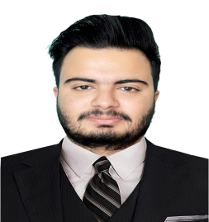
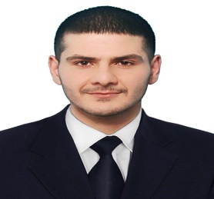
Biyar Salah Sdeeq
Zakeria Ibrahim Mohammed
Baraa Shakir Mahmoud
Yousef Sohail Ahmed
Ahmed Tawfiq Ismael
Dr Amina Alkhayat
Supervised By
Presented by
Dr Janan Alrahoo

Slide 4
Introduction
- Personality is an essential concept in psychology, as it refers to the unique characteristics of an Individual that govern their behavior, emotions, and thoughts
- It is a structure gathering interrelated behavioral, cognitive and emotional patterns that biological and environmental factors influence; these Interrelated patterns are relatively stable over time periods, but they change over the entire lifetime.

Slide 5
Positive personality is a trait that refers to individuals who have a positive outlook on life, emotions, and behaviors Engaged. It is often associated with good mental health, happiness, thriving and promote personal growth

Slide 7
Objectives
1- Prevalence Of positive Personality of medical students
2- Prevalence Of positive personality According to Gender
3- Prevalence Of positive personality According to Age
4- Prevalence Of positive personality According to Stage

Slide 8
Methodology
1) Study design : we do a Cross-sectional Study in our research about prevalence of Positive Personality among medical students and its relationship to some variables
2) Study population : the study was done on students of Ninevah University-the College of Medicine ( 1652 students ) .
3) Study sampling : the sample was 20% of the population ) 328 students ,Male 151 ( 46.04% ), Female 177 ( 53.96% ) .

Slide 9
4) Time of the study : we start our research from 20 March 2023 to 11 April 2023 .
5) Place of the study : the study was done in Ninevah University-the College of Medicine
6) Instruments of the study : we used an anonymous self-completed questionnaire contain 26 questions about the following :
- demographic information : gender, age, year of study .

Slide 10
- We have read some research sources and psychological books on positive personality and completed 23 phrases in the questionnaire , divided as following : personal (psychological) questions, social questions, and academic questions
7) Data collection : all data were collected using paper questionnaires , according to the percentages mentioned above ( 20% )

Slide 11
8) Data analysis : All statistical analyses were done using the Microsoft Excel program
9) Ethical consideration : our study respect all ethical consideration of the sample and all the information were collected in the privacy

Slide 13
Results

Slide 15
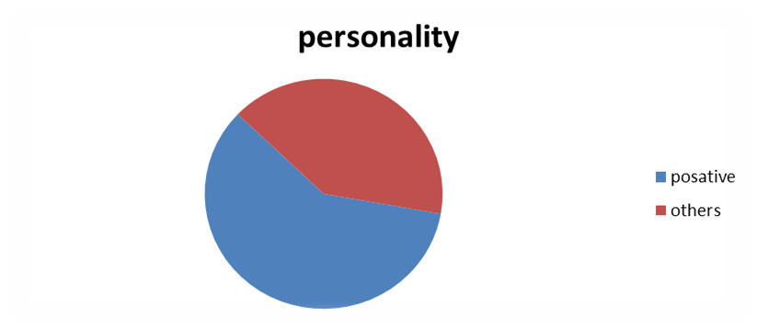
This Figure show the percentage of the positive 59.4% and negative personality 40.6% in the sample

Slide 17
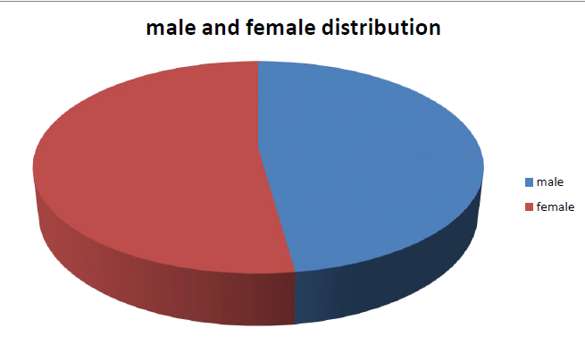

Slide 22
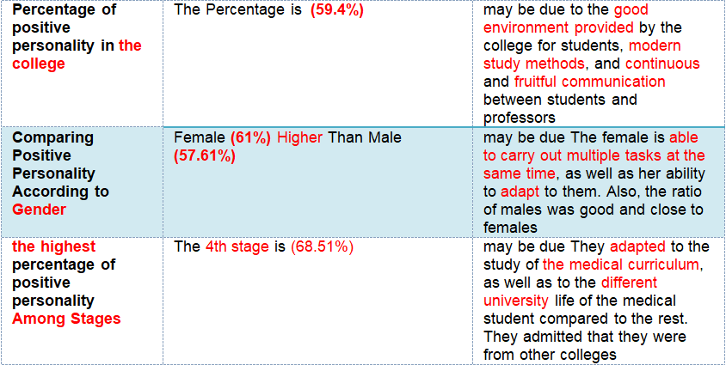
Discussion

Slide 25
Conclusion
In our study about Prevalence of positive personality Among the Medical students of different stages at The University of Ninevah College Of Medicine. We noticed that High Ratio of positive personality .The fourth stage students had a positive personality more than other stages also females had positive personality more than male and we saw many factors and aspects that contribute on the positivity of the students

Slide 26
Recommendation
1- Need to maintain and support an environment that supports a positive personality.
2-Avoid negative people and someone who may affect your positive personality and your academic performance.
3-It is recommended for future research to do in different universities and countries to see the effect of different cultures and communities on the development of personality.

