Slide 2
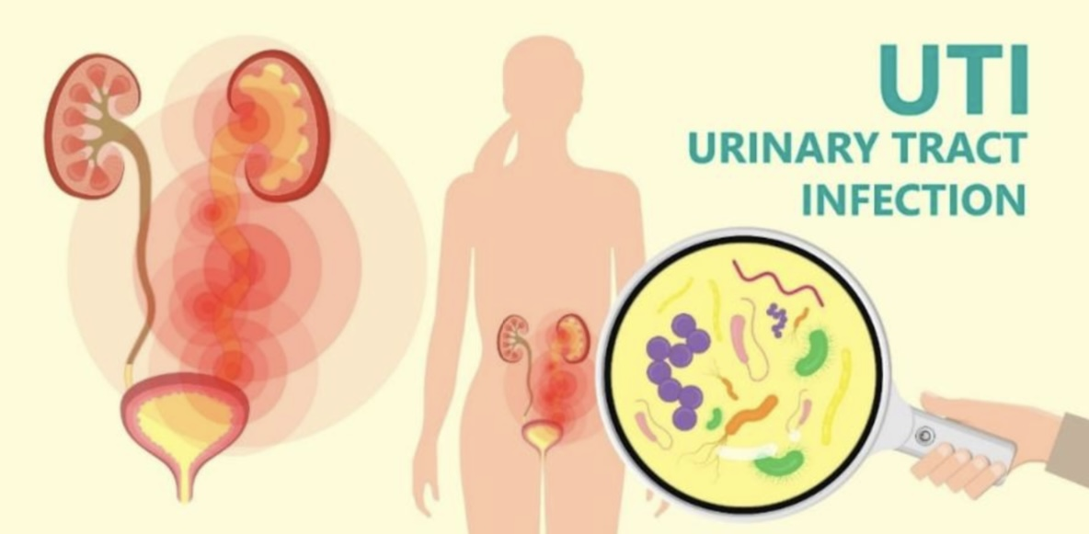
Urinary tract infection
Among patients in Mosul city

Slide 3
Supervised by:-
Dr.Dhelal Ahmad Al-jumaily
Department of family and community medicine
Asst. Prof. Dr. Nada Fadil Al-Rawi
Head of the medical biology division

Slide 4
Presented by
Ali Mahmood Hadi. Mohammed Suhail Najim.
Zaid Madhat Hadi. Shahad Ramadan Mutar.
Lylan Shukry Mohammed. Salam Hachem Hussien.

Slide 5
Introduction :-
Urinary Tract Infections are one of the most common infections in the world that affect various areas of the urinary system and can affect both sexes equally frequently. Women are more vulnerable than males because of their anatomy and reproductive system. The infection results from bacterial invasion of the urinary tract, including the upper and lower urinary tracts. Escherichia coli, one of the bacterial species, is responsible for 80% to 85% of infections, followed by Staphylococcus species, which make up 10%
Intoduction :-
Urinary Tract Infections are one of the most common infections in the world that affect various areas of the urinary system and can affect both sexes equally frequently [1]. Women are more vulnerable than males because of their anatomy and reproductive system
the infection results from bacterial invasion of the urinary tract, including the upper and lower urinary tracts. Escherichia coli, one of the bacterial species, is responsible for 80% to 85% of infections, followed by Staphylococcus species, which make up 10%

Slide 6
The objectives of this study :-
1- is to identify the types of bacteria that cause UTIs.
2- To identify the age group most susceptible to urinary tract infections, as well as the effect of sex on the incidence of UTIs.
3- To find out which antibiotics are most effective against the bacteria that cause UTIs.

Slide 7
Methods:
Study design : cross sectional study.
Study setting : Al-Salam hospital Al-Rabie hospital and the laboratory od Dr. Radwan Al- Jammas in the Mosul city.
Screening period : for 2 months .
Sampling : 50 random samples of males and females.
Analysis : done by Microsoft Excel 2013.
Urine samplels were cultured on McConkey and Blood culture media, as well as the bacteria were diagnosed by macroscopic and Microscopic examinations in addition of biochemical tests.
Sensitivity test for antibiotics was also performed using kirby bauer method.

Slide 8
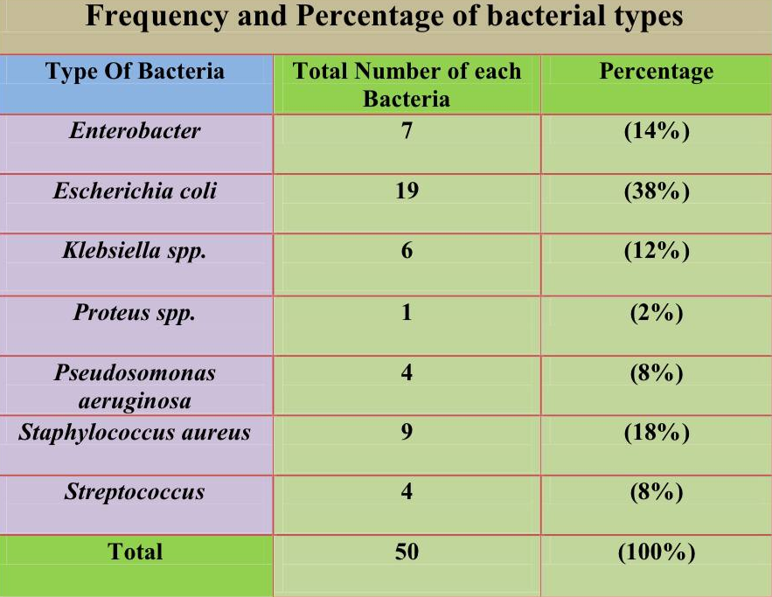
Precentage of incidence of urinary tract infection in males and females
Table 1 :-

Slide 9
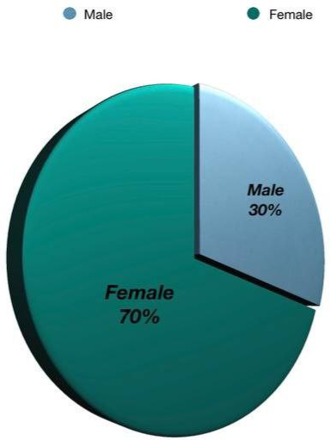
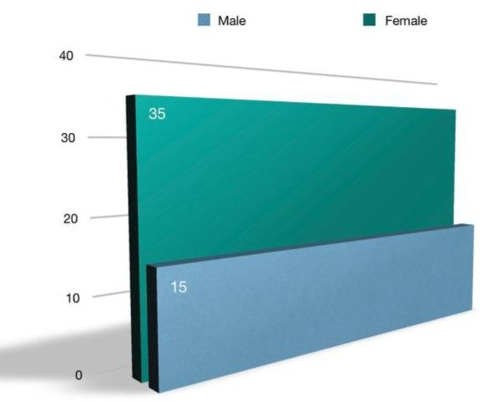
Figure 2 & 3 results according to sex

Slide 10
Discussion:
Discussing results according to sex (Table 1) (Figure 2 & 3) :-
There was 50 samples involved in our study the majority of samples are females 70% (n=35 ) and males 30% (n=15) ,and the most common bacteria are Escherichia coli 38% (n=19),Staphylococcus aureus 18%(n=9) and Enterobacter 14%(n=7).

Slide 11
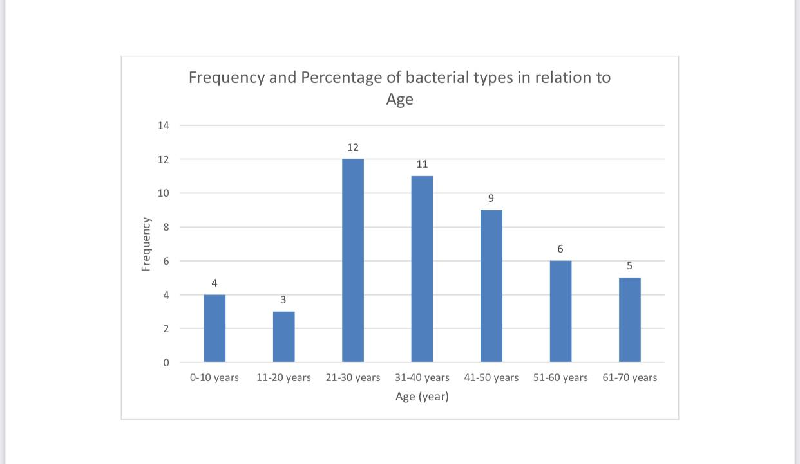
Figure 1

Slide 12
Discussing results according to age (Figure 1) :-
The results of the current study showed that the highest
incidence of urinary tract infections among hospital visitors in the Mosul city was within the age group (21- 30) years for
both sexes, at a rate of (24%) ,While the incidence rate among
the age groups (11-20) is (6% )which is the lowest rate among age groups.

Slide 13
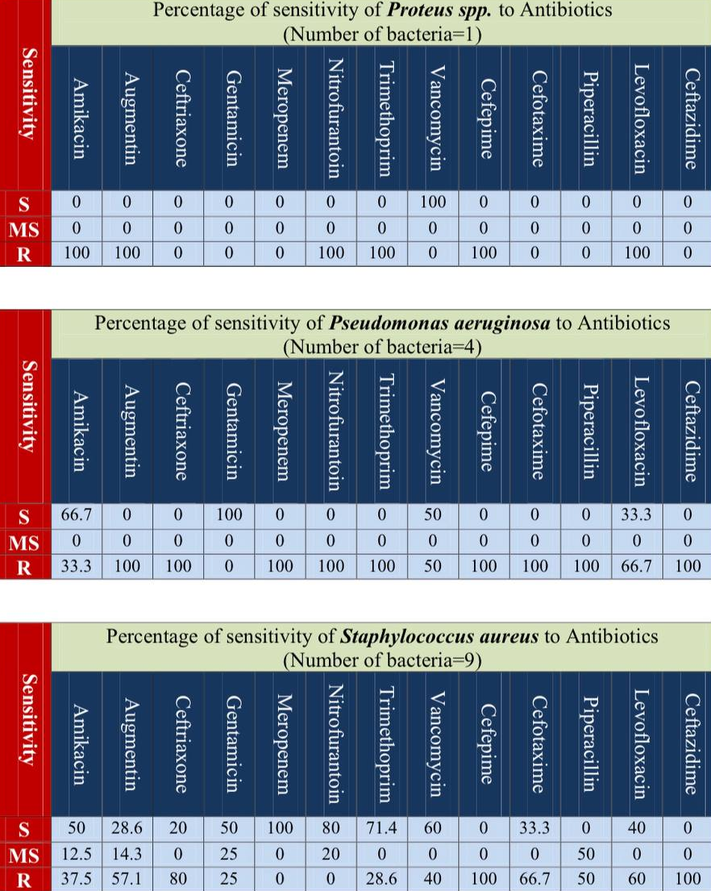
Table 2 :
Table 3 :
Table 4 :

Slide 14
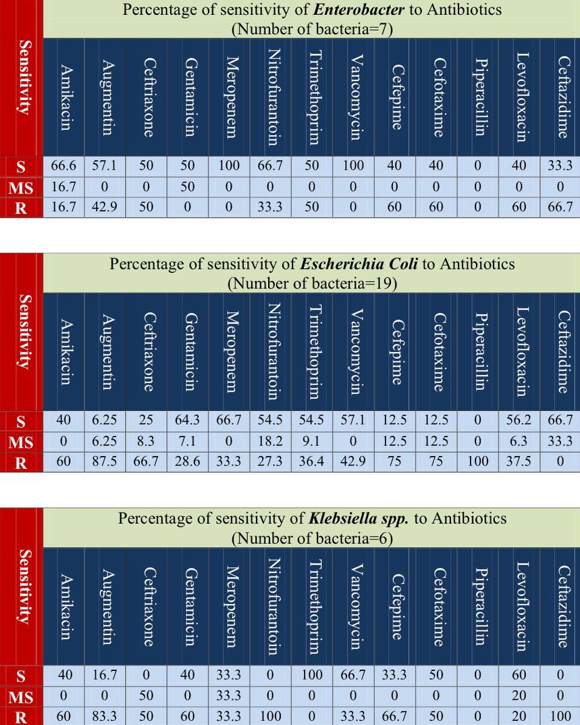
Table 5 :
Table 6 :
Table 7 :

Slide 15
Table 8 :

Slide 16
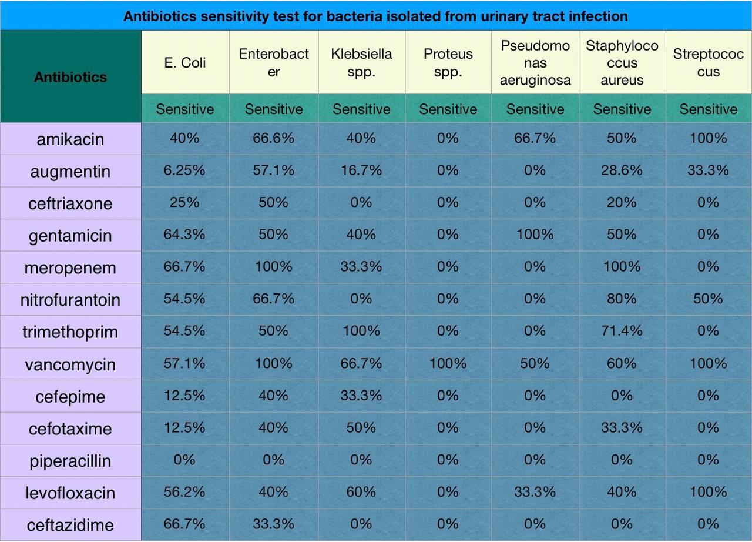
Table 9 :

Slide 17
Discussing results of all bacteria sensitivity to antibiotics (Table 9) :-
The most effective antibiotics against different types of bacteria that isolated from Urinary tract infection is Vancomycin.Escherichia coli and Klebsiella pneumoniae, and athers type of bacteria resistant to piperacillin/tazobactam (TZP) The resistance mechanism associated with this phenotype has been identified as hyperproduction of the β-lactamase TEM. However, the mechanism of hyperproduction due to gene amplification is not well understood.

Slide 18
Conclusion:
1-The most common type of bacteria that cause UTI is E.coli(38%).
2- the sex that is more affected by UTI is female( 70%).
3-The most common age for UTI is between 21 and 30.
4- The most effective type of antibiotic for bacteria is vancomycin. 5- Less sensitive antibiotic type for different types of bacteria is piperacillin

Slide 19
Recommendation:
It is necessary to know what gender and age group are most susceptible to infection with urinary tract infections, what are the most common types of bacteria that cause this disease and to study how some risk factors like hypertension, diabetes and pregnancy affect the infection with UTI and methods of treatment of complications if they occure, and to conduct more research in a more detailed mannor in the future on this disease.

