Slide 1
Ninevah University College of Medicine
بحوث طلبتنا ..... تألق معرفي
وإبداع متميز
المؤتمر العلمي الطلابي السادس
2022-2023

Slide 2
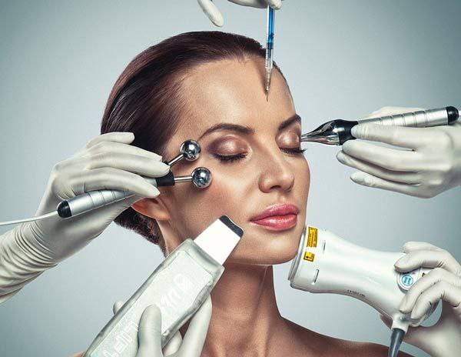
Satisfaction of females about their appearance and motivation for aesthetic procedures

Slide 3
Presented by :
Russl Raad Abdulrahman
Zakaria Faris Ali
Mustafa Basim Salih
Maog Mohammed Essa
Zahra Laith Ahmed
Tasneem Essam Shukur

Slide 4
Introduction :
Aesthetic procedures have become increasingly popular over the last decades and features of the “ideal” face have been extensively described.
In a qualitative interview study of patients seeking minimally invasive cosmetic procedures, the main reasons for requesting treatment were to improve physical and psychosocial wellbeing; the desire for cosmetic improvement was only a small component of their motivation.

Slide 5
Objectives :
1- To determine the satisfaction of females about their appearance .
2- To determine the motivation of women for aesthetics procedures .
3- To determine the relationship between the satisfaction of appearance with age, educational level, and economic status .

Slide 6
Methodology :
Cross sectional study applied on 188 females in mosul city.
Duration of our study about 4 months from 4th December to 7th April.
The data was collected by using an online questionnaire by google sheet, our questionnaire was collected and made by asking and meeting with the patients who cames to manar derma clinic with the help of Dr.Manar.
All data management and analysis was done by using Excel.
in which consent was obtained in advance of participation.

Slide 7
Results :
Table (1): The distribution of the study sample according to sociodemographic characterstics.
age | number | %
15-25 | 115 | 61.2
25-35 | 46 | 24.5
35-45 | 14 | 7.4
45-55 | 7 | 3.7
over 55 | 6 | 3.2
Marital Status | number | %
Single | 115 | 61.2
married | 62 | 33
divorced | 5 | 2.7
widow | 6 | 3.2
Living | number | %
the countryside | 19 | 10.1
City | 169 | 89.9

Slide 8
The job | number | %
Housewife | 34 | 18.1
student | 116 | 61.7
employee | 38 | 20.2
Academic achievement | number | %
Primary | 14 | 7.4
Intermediate | 22 | 22
high school | 29 | 15.4
Bachelor Degree | 118 | 62.8
Master's Degree | 5 | 2.7
Economic status | number | %
good | 85 | 45.2
weak | 9 | 4.8
Medium | 83 | 44.1
Excellent | 11 | 5.9

Slide 9
Figure(1): The females satisfied with their appearance.

Slide 10
Figure(3):The three biggest motivation for the aesthetic procedures.

Slide 11
Figure(3). Psychological motives for aesthetic procedures.

Slide 12
Figure (4). Social motives for aesthetic procedures.

Slide 14
Discussion :
After reviewing the results of our study, we notice that most of the females who attend these centers ranged between (15-25) year, which their percentage (61.2%) , perhaps because it is the most age in which women search for their beauty and are eager on their outward appearance.

Slide 15
The biggest motive for the aesthetic procedures are the psychological motives (45%) which includes high percentage, Much of them for gain self-confidence.
The social motives that affect aesthetic procedures (35%) is high but less than the psychological motives.
The financial motives for the visiting the beauty center who have abundant of money (20%).

Slide 16
Effect of female friends (42%) who doing the aesthetic procedures; our study is nearly similar to that was done in the AL-Riyadh city, Saudi Arabia it was (48.5%) ,this is may be due to the same locality between our Arab cities.
Other effects is the advice from others (25%) and the effect of famous female(23%) seen by social media
Bullying effect(10%) on some female by others, pushing them to visit the beauty centers to change their appearance as much as possible to become more beautiful, even so their financial level is low; this may occurs in females who have had aweak personality.

Slide 17
That means that only (50%) of females who undergo aesthetic procedure are satisfied with the results, this may reffered to the fact that aesthetic procedure is not the only solution to make a female satisfied with her appearance.
The other (50%) of the females are not satisfied for these procedures; and these procedures may be failed, so the appearance becomes more bad and unacceptable by others; and so the female will pay the coast; and she will be enter in a new viscous cycle.

Slide 18
Conclusion :
We concluded that the age group between (15-25) is the largest group.
Most of them are satisfied with their appearance.
A lot of them need to have aesthetic procedure to gain self-confidence and also attract the attention of others.
More than half of the women in our study had psychological problems because of their appearance.
The role of social media has played a major role in attracting the vast majority of women to beauty centers.
Only half of those who underwent Aesthetic procedure are satisfied with the results.
Most women are from good fanincial state.

Slide 19
Recommendation :
Accept your outward appearance.
follow a healthy lifestyle.
choose good clothes.
Focus on your insight, feeding your mind with information, reading, and acquiring skills, and experiences in life is more important than focusing on the secondary aspects of life and outward appearance, because what distinguishes people is the mind, not the appearance.
But certainly there are special cases that need to aesthetic procedures can help improve the psychological and health status of individuals, and in this case these procedures will have an important role in achieving the desired goal and satisfying people with their appearance.

